Slide 1
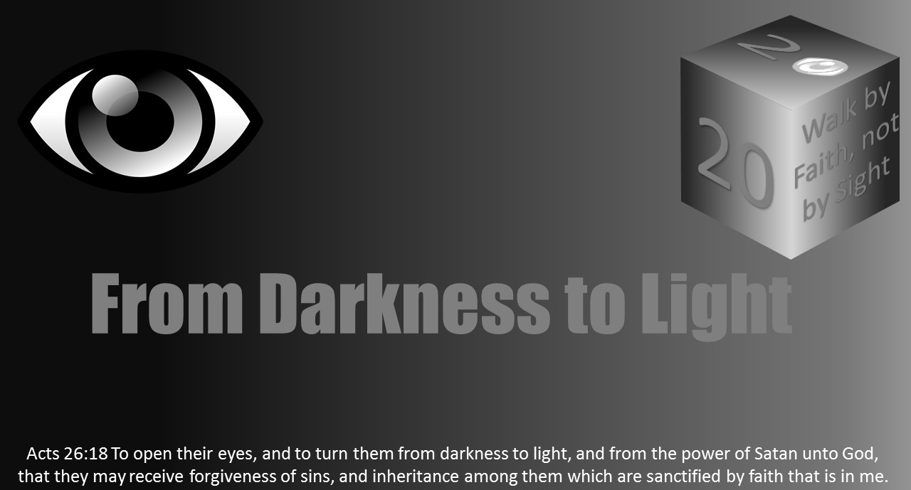


Slide 2
Light Lesson 12 Light and Holiness

Slide 3
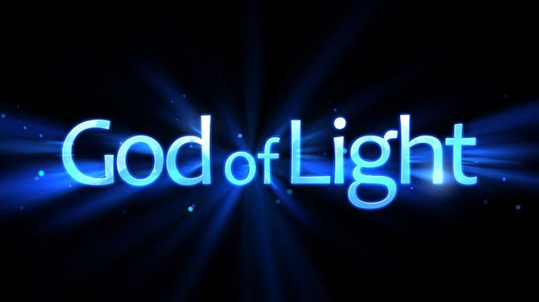
Introduction
God is light.
Darkness is evil.
Jesus is the true light.
Christians are to walk as children of light.
Holiness is God’s permeating quality that encompasses attributes such as light.
In calling on His children to have the relationship of light with Him, God also calls us to be holy.

Slide 4
Introduction
R.C. Sproul commented on God’s holiness by saying:
"The Bible says that God is holy, holy, holy. Not that He is merely holy, or even holy, holy. He is holy, holy, holy. The Bible never says that God is love, love, love, or mercy, mercy, mercy, or wrath, wrath, wrath, or justice, justice, justice. It does say that He is holy, holy, holy, the whole earth is full of His glory.”

Slide 5
Introduction
The picture of a person is really an image and not the true person.
God’s image, or our understanding of Him, is tied to love, light, righteousness, and holiness.
Ephesians 4:23-24, Colossians 3:10, and 2 Peter 1:3-4 teach Christians are to be transformed and renewed into the image of the Lord. (See also Romans 12:1-2.)
Just as we see a parent in a child, as God’s children, we are reprints of His image.
Thus, when a person looks at a Christian, they should see God’s image reflected in their walk.

Slide 6

God Is Light and Love
As God’s image bearers, Christians are to be lights in this world.
“God is light, and in him is no darkness at all” (1 John 1:5).
Light is a common metaphor in the Bible for righteousness and goodness.
Righteousness is symbolized as the morning sun in Proverbs 4:18. Light is associated with God and His word in Psalms 119:105 and Proverbs 6:23. In Psalms 27:1, God is light and salvation. Good works are pictured as light in Matthew 5:16 and Psalms 76:4. God is radiant with light in Psalm 76:4. God dwells in unapproachable light as 1 Timothy 6:16 uses to describe His glory and holiness. God is the Father of Lights without shadow or turning in James 1:17. He is the Light of heaven (Revelation 21:23).

Slide 7
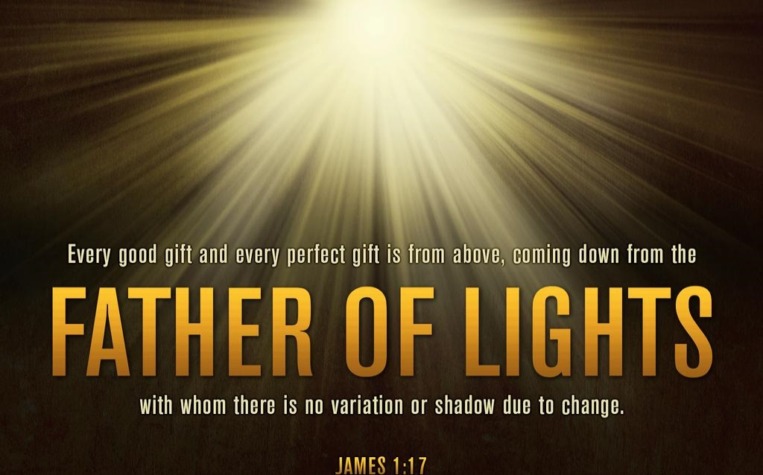
God Is Light and Love
In addition to God being light, God is love (1 John 4:8).
Those who use His promises to escape the corruption in the world can become partakers of His divine nature (2 Peter 1:3-4).
God’s nature is light, love, and holy yielding for us joy and hope. There is no threat of darkness with despair or misery in His light and love. No small print in the understanding or hidden shadow is in God's light.

Slide 8
Darkness Is Evil
On the other hand, darkness is the metaphor that signifies sin and evil, including distress, trouble, and sorrow.
1 John 1:6 teaches, “If we say that we have fellowship with Him, and walk in darkness, we lie, and do not the truth.”
By contrast, “…God is light, and in Him is no darkness at all …because the darkness is past, and the true light now shineth. He that saith he is in the light, and hateth his brother, is in darkness even until now. He that loveth his brother abideth in the light, and there is none occasion of stumbling in him. But he that hateth his brother is in darkness, and walketh in darkness, and knoweth not whither he goeth, because that darkness hath blinded his eyes” (1 John 1:5; 2:8-11).

Slide 9
Darkness Is Evil
In addition, darkness represents the wicked in Proverbs 2:13, judgment in Exodus 10:21, and death in Psalms 88:12.
Jesus calls Hell “outer darkness” (Matthew 8:12; 22:13; 25:30).
While walking in darkness, we are spiritually blinded, and reach for a comforting object or pleasure. In this state of blindness, we become enslaved to the sin and temptations Satan is using.
Darkness causes us to make mistakes we would not make if we could see.
Darkness is Satan’s tool.

Slide 10
Jesus Is the True Light
Jesus is the radiance and the express image of the Father, and He is the light of the world.
If the Old Law was a shadow, then Jesus is the true image of God expressed.
“God, who at sundry times and in divers manners spake in time past unto the fathers by the prophets, Hath in these last days spoken unto us by his Son, whom he hath appointed heir of all things, by whom also he made the worlds; Who being the brightness of his glory, and the express image of his person, and upholding all things by the word of his power, when he had by himself purged our sins, sat down on the right hand of the Majesty on high” (Hebrews 1:1-3).

Slide 11
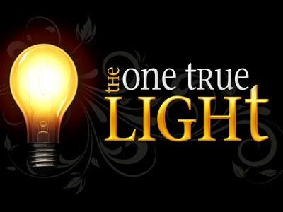
Jesus Is the True Light
In John 8:12, Jesus states, “I am the light of the world: he that followeth me shall not walk in darkness, but shall have the light of life.”
We understand Christians are meant to walk and grow in holiness and mature in the faith by following the Messiah.
2 Peter 3:18 teaches, “But grow in grace, and in the knowledge of our Lord and Saviour Jesus Christ.”
His light covers all darkness, comforts Christians, and is a guiding lamp , especially in times of trouble or trial. He challenges us to believe in that light.
Jesus says, “Yet a little while is the light with you. Walk while ye have the light, lest darkness come upon you: for he that walketh in darkness knoweth not whither he goeth. While ye have light, believe in the light, that ye may be the children of light” (John 12:35-36).
See also John’s identification in John 1:6-9. See also Isaiah’s foretelling of Jesus as the light in Isaiah 42:6,7,16 and 60:1-3, 19-20.

Slide 12

Children of Light
We are taught as children of God to walk in the light in 1 John 1:5-10.
The cornerstone is that God is light, and in Him there is no darkness.
The application in verses 6-7 is about our relationship with Him based on us walking in the light, not in darkness.
Jesus describes His disciples as light bearers in Matthew 5:14-16.
Christians’ lives are a shining light and witness to the world.
“For ye were sometimes darkness, but now are ye light in the Lord: walk as children of light” (Ephesians 5:8).

Slide 13
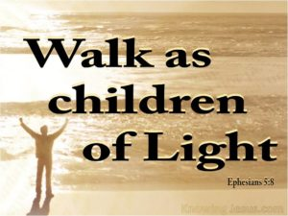
Children of Light
As His children, we should put on the armor of light.
“The night is far spent, the day is at hand: let us therefore cast off the works of darkness, and let us put on the armour of light” (Romans 13:12).
“Ye are all the children of light, and the children of the day: we are not of the night, nor of darkness” (1 Thessalonians 5:5).
Thus, to walk in the light means to know God and to live righteously and holy.
“As obedient children, not fashioning yourselves according to the former lusts in your ignorance: But as he which hath called you is holy, so be ye holy in all manner of conversation; Because it is written, Be ye holy; for I am holy” (1 Peter 1:14-16).

Slide 14
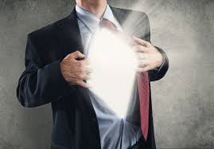
Children of Light
For my finite mind, I use the brightest light I know to think of God’s radiance, the Sun.
I use the light beam that travels to earth to understand Christ as the express radiance.
As His image bearer, I am the reflector or mirror to carry that light to the lost.

Slide 15
Children of Light
Christians cannot continue in the darkness of sin.
Sin is separation from God.
Christ’s light banishes the darkness from our lives.
“The people that walked in darkness have seen a great light: they that dwell in the land of the shadow of death, upon them hath the light shined” (Isaiah 9:2).
Some folks like the darkness and are uncomfortable in the light.
“And this is the condemnation, that light is come into the world, and men loved darkness rather than light, because their deeds were evil. For every one that doeth evil hateth the light, neither cometh to the light, lest his deeds should be reproved. But he that doeth truth cometh to the light, that his deeds may be made manifest, that they are wrought in God” (John 3:19-21).

Slide 16

Children of Light
As the true light, Jesus came that His followers might be adopted sons of God.
We must reflect His light into a world darkened by sin.
As His image bearers, we seek “to open their eyes and turn them from darkness to light, and from the power of Satan to God.” (Acts 26:18).

Slide 17
Light and Holiness
God is light. Darkness is evil.
Jesus is the true light.
Christians are to walk as children of light.
Holiness is God’s permeating quality that encompasses attributes such as light.
In calling on His children to have the relationship in light with Him, God also calls us to be holy.
What does it mean to partake or perfect holiness as a Christian?

